Slide 1
Phase 3
Name – Shikha Shekhar
Email-id-shikha.15je001654@agl.iitism.ac.in

Slide 2
Problem Statement
Vertical : Consumer Packaged Goods & Retail
Consumer packaged goods (CPG) are items used daily by average consumers that require routine replacement or replenishment, such as food, beverages, clothes, tobacco, makeup, and household products.
This is a highly competitive sector, due to high market saturation and low consumer switching costs, where consumers can easily and cheaply switch their brand loyalties.
Therefore, understanding consumer behavior pattern becomes important for every CPG related firm to choose advertisement and promotional schemes, which can not only help in customer retention but also attract different customers.

Slide 3
Problem Statement
We have data of an Audiobook app.
Each customer in the database has made a purchase at least once, that's why he/she is in the database. We want to create a deep learning algorithm based on our available data that can predict if a customer will buy again from the Audiobook company.
"The main idea is that if a customer has a low probability of coming back, there is no reason to spend any money on advertising to him/her. If we can focus our efforts ONLY on customers that are likely to convert again, we can make great savings”. Moreover, this model can identify the most important metrics for a customer to come back again. Identifying new customers creates value and growth opportunities.

Slide 4
Datasets
The database comprises of two years’ worth of engagement and another six months data to train the model to check if a consumer converted or not.
There are several variables: Customer ID, Book length in mins_avg (average of all purchases), Book length in minutes_sum (sum of all purchases), Price Paid_avg (average of all purchases), Price paid_sum (sum of all purchases), Review (a Boolean variable), Review (out of 10), Total minutes listened, Completion (from 0 to 1), Support requests (number), and Last visited minus purchase date (in days).So these are the inputs (excluding customer ID, as it is completely arbitrary). The targets are a Boolean variable (so 0, or 1).

Slide 5
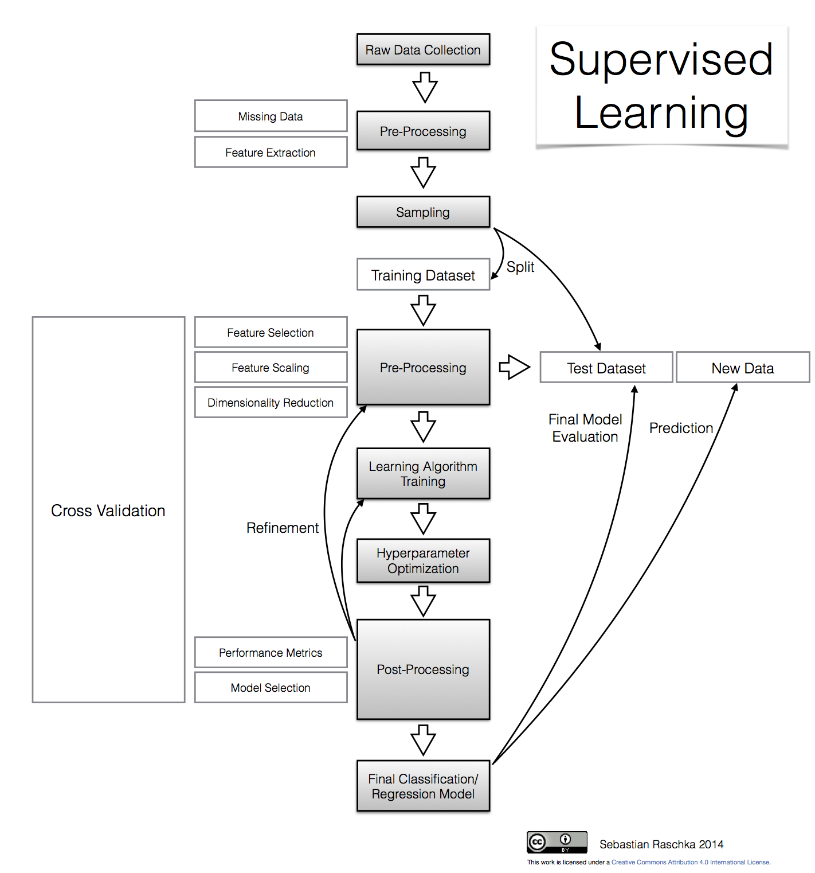
Approach
A Systematic approach carried out for setting up a deep learning model.

Slide 6
Pre-processing
Learning Algorithm Training
Hyperparameter Optimization
Final Classification Model
The preprocessing part has been divided into three parts and it is explained why it has been done:
Balancing the dataset: The datasets that have been procured should be balanced that means equal representation of every class should be present. In this particular problem we have two classes 0 and 1. So when we train our model it has equal chances of learning from both the classes.

Slide 7
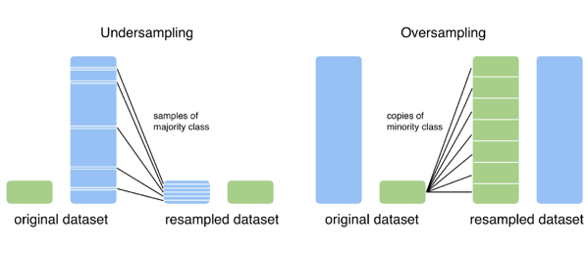
For this particular study, we have undersampled the dataset which reduced the dataset from 14000 to 4474 dataset.
We can also oversample the data which will increase the dataset.
Sample No. | Mean of sample data (After Balancing)
Train - 3579 | 0.5
Validation - 447 | 0.48
Test - 448 | 0.49

Slide 8
Pre-processing
Learning Algorithm Training
Hyperparameter Optimization
Final Classification Model
Shuffling Dataset: The dataset should be shuffled randomly so that there is no pattern in the data. It could be that the data is arranged on the basis of date of purchase. Therefore the dataset should be shuffled before feeding into the model so that any pattern could be avoided.
Normalization of input feature: The input feature is normalized (subtracted by mean and divided by standard deviation) so that the data converts to a standard scale.
Splitting dataset into training, validation and test dataset: The datasets will be classified into training, validation and test dataset in the ratio of 80, 10 and 10 respectively.
Saving dataset into TensorFlow friendly format: In this study we will be using TensorFlow programming framework in Python for developing the model.

Slide 9
Pre-processing
Learning Algorithm Training
Hyperparameter Optimization
Final Classification Model
The next step involves setting up the learning algorithm for training model.
ADAM was selected as optimization algorithm.
sparse_categorical_crossentropy was selected as cost function for this model.
Accuracy was chosen as evaluation metrics.
Different callback functions like early stopping, saving weight of best model and Tensorboard were also defined to visualize, monitor and improve our Deep learning model.

Slide 10
Pre-processing
Learning Algorithm Training
Hyperparameter Optimization
Final Classification Model
After defining optimization algorithm, cost function etc… we fiddled with different hyperparameters to build a model with best accuracy. Different models were set up by changing batch size, hidden layers, nodes in hidden layers, Regularization method etc.. to build a good fitted classification model.

Slide 11
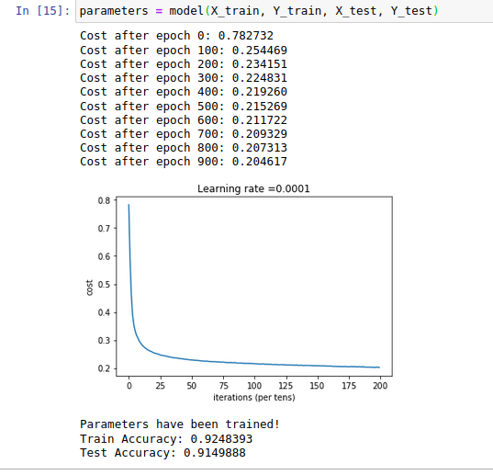
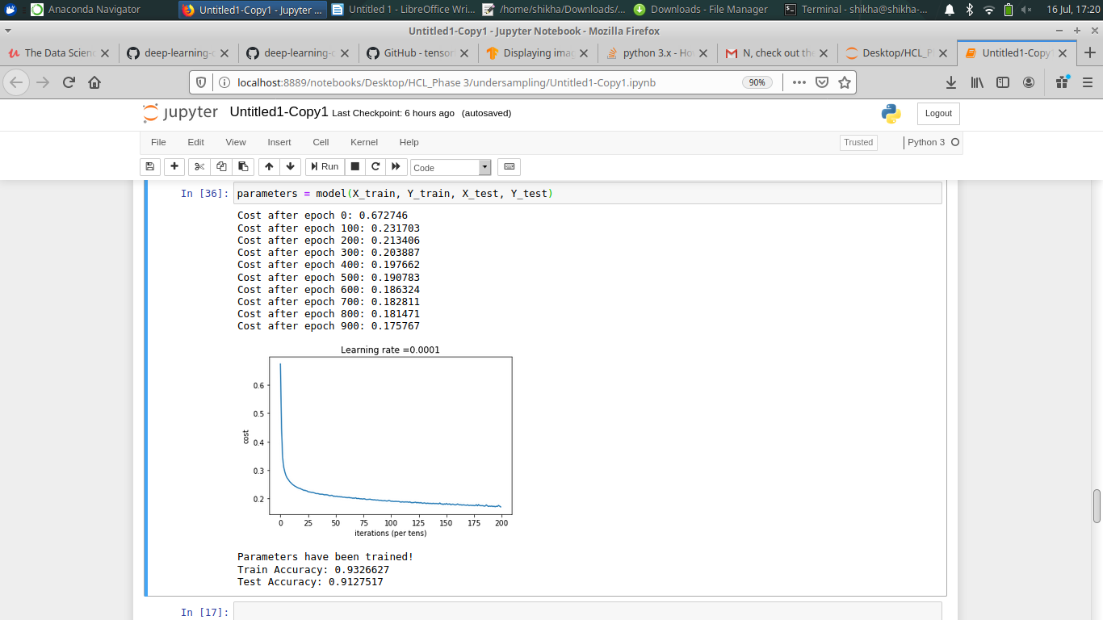
Pre-processing
Learning Algorithm Training
Hyperparameter Optimization
Final Classification Model
Hidden layers- 2, No regularization, Hidden_input_size-50
B. Hidden layers- 3, No regularization, Hidden_input_size-64,64,32 respectively.

Slide 12
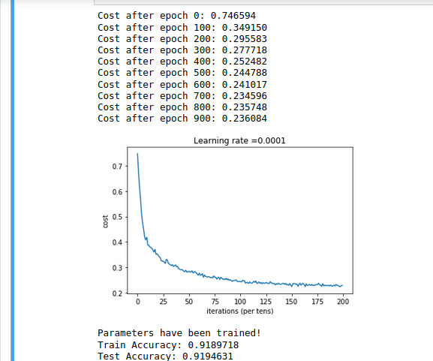
Pre-processing
Learning Algorithm Training
Hyperparameter Optimization
Final Classification Model
Several other model were built by changing hidden layers, batch size, optimization algorithm (SGD), changing keep_prob parameter for Dropout regularization method etc...
C. Hidden layers- 3, Dropout regularization, Hidden_input_size-64,64,32

Slide 13
Pre-processing
Learning Algorithm Training
Hyperparameter Optimization
Final Classification Model
The best suited model for our study was found to be model with 2 hidden layers with 64 nodes each, with batch size equal to 100, Adam as optimization algorithm, and Dropout regularization method with a keep_prob of 0.7.
The training accuracy of the model was 90.28% and validation accuracy was 92.17%.

Slide 14
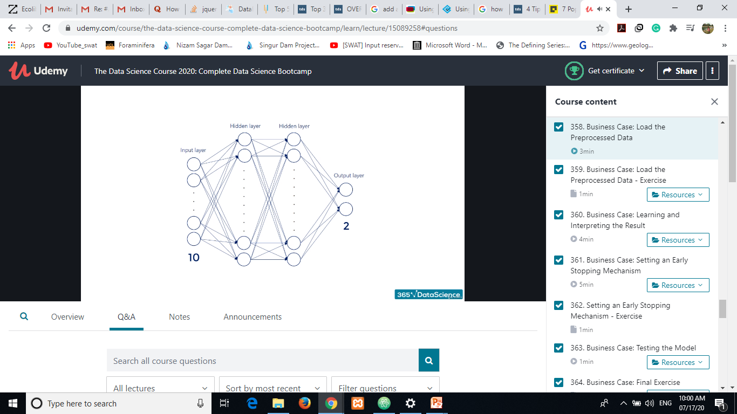
Pre-processing
Learning Algorithm Training
Hyperparameter Optimization
Final Classification Model
Deep Learning Model
Hidden layer-2
Hidden layer nodes - 64

Slide 15
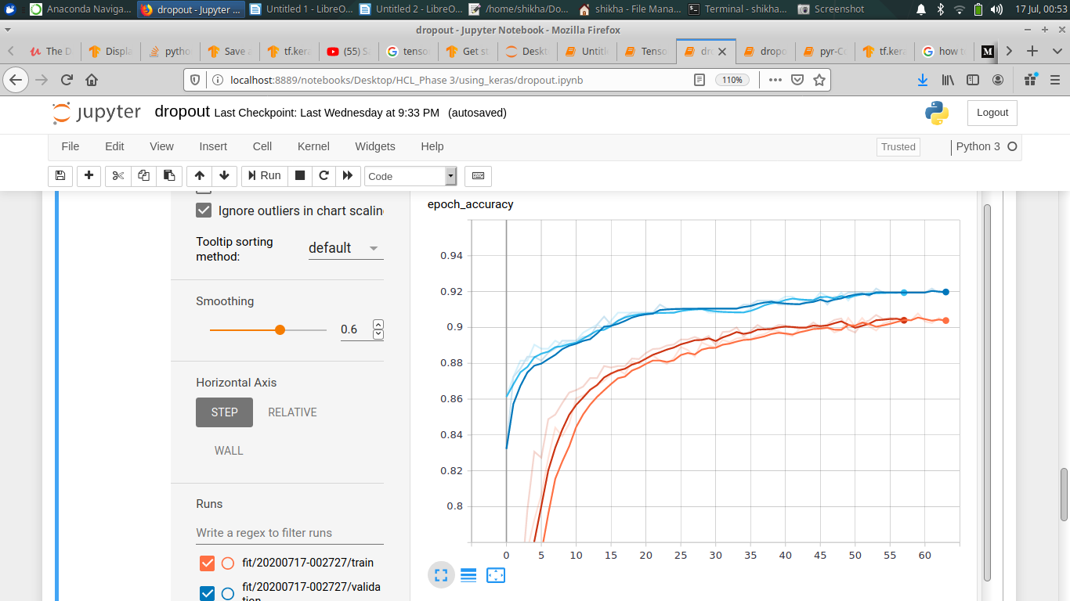
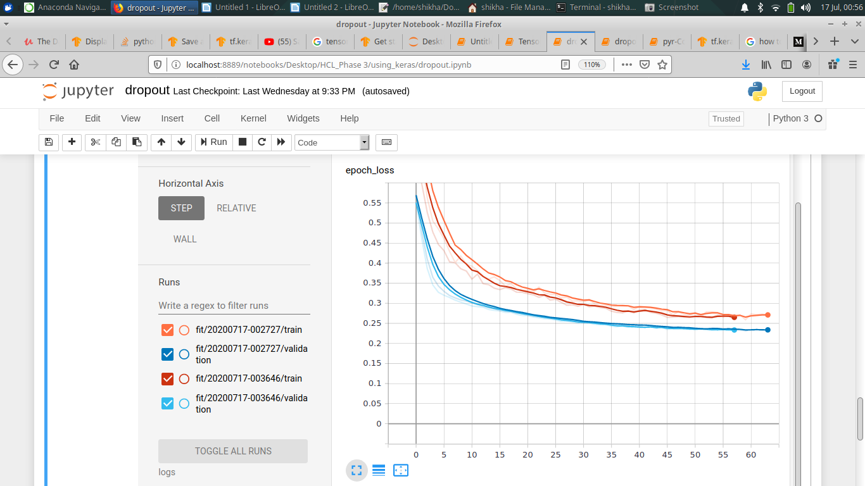
Pre-processing
Learning Algorithm Training
Hyperparameter Optimization
Final Classification Model
Model Accuracy vs epoch
Model loss vs epoch

Slide 16
Pre-processing
Learning Algorithm Training
Hyperparameter Optimization
Final Classification Model
The weights of the input corresponding to best validation accuracy is saved in best_model.hdf5 file.
The weights for all the epochs is saved in cp.cpkt file.
The model was tested for test data and the accuracy was found to be 92.19%.

Slide 17
Future Work
The model could be further tuned to obtain better accuracy like using oversampling method to balance unbalanced data.
Other regularization method and other metrics could also be used for getting better results.

Slide 18
Incorporating Features of IT Dataset
We already have an input feature representing the no. of times consumer has left a support request (IT Dataset). It represents how often a consumer has interacted with the platform.
This study could be further carried out by including the type of request left by consumers, they could be clustered together in different group.
Features like:
Technical Hardware related issue
Problem playing Audiobook
Problem finding purchased audiobook
Problem Signing in
Return/Purchase Issue
Customer care
These IT ticket feature along with customer engagement dataset could provide insights and customer behaviour pattern. the dataset could help identifying potential customers and further clustering customer based on their IT ticket history which can direct their problem to correct desk helping them to resolve their issue faster.

Slide 19
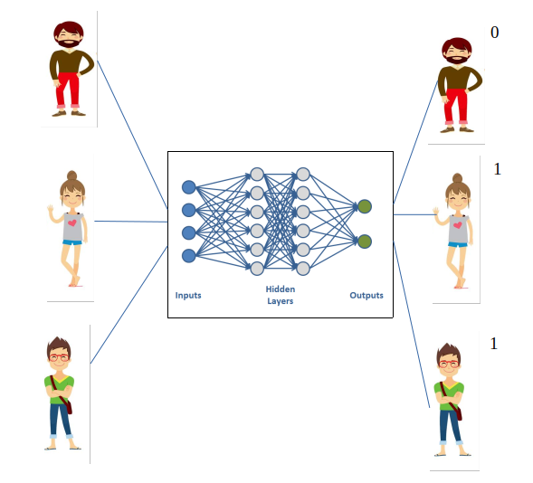
Conclusion
The classification model helped in identifying the potential customers using which the company could come up with different strategies of retaining potential customers and attracting customers who are less probable to convert and thus optimizing company’s advertising budget.

